Slide 1

Latency Sensitive Microservices in Java
What Microservices can learn from Trading Systems and visa versa.
Peter Lawrey - CEO of Higher Frequency Trading
Docklands LJC - 2016

Slide 2
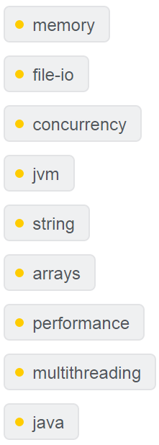
Peter Lawrey
Java Developer / Consultant for investment banks and hedge funds for 9 years.
Most answers for Java and JVM on stackoverflow.com

Slide 3
Chronicle Software
Build a skeleton high performance system in Java in a one week workshop.

Slide 4
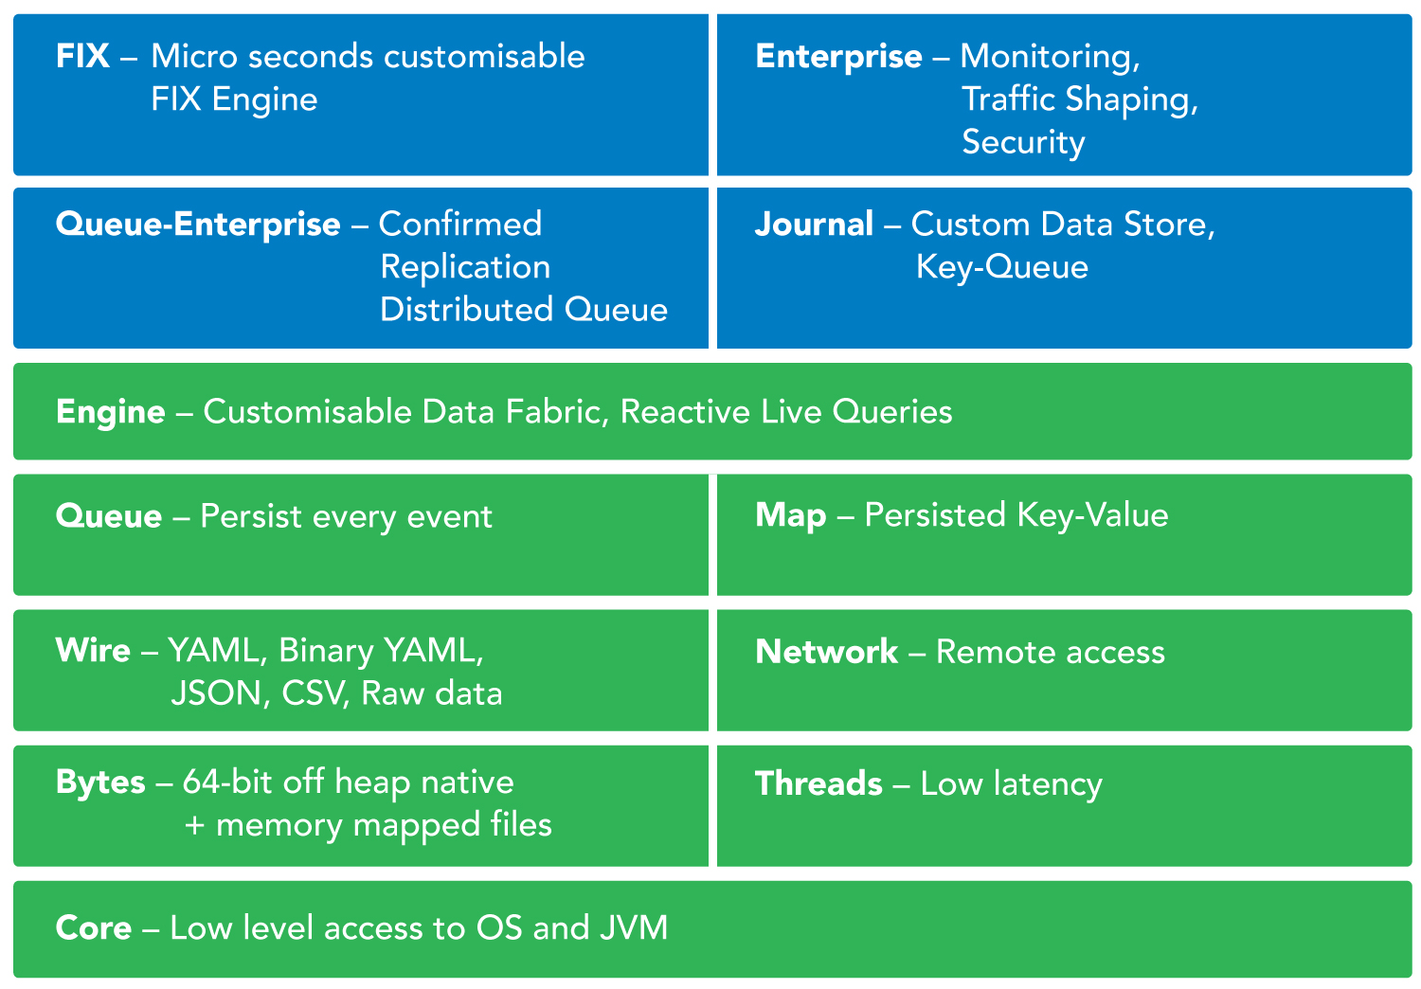

Slide 5
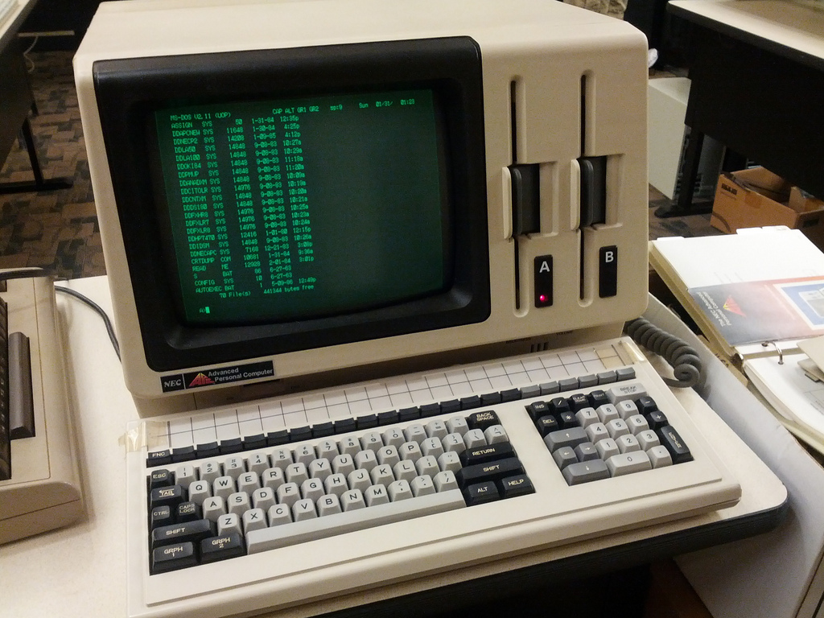
128 KB RAM

Slide 6
Where do Microservices come from?
UNIX Principle.
Staged Event Driven Architecture.
Service Orientated Architecture.
Lambda Architecture.
Reactive Streams.

Slide 7
Where do Microservices come from?
Used in building Web applications.
“Micro-Web-Services”

Slide 8
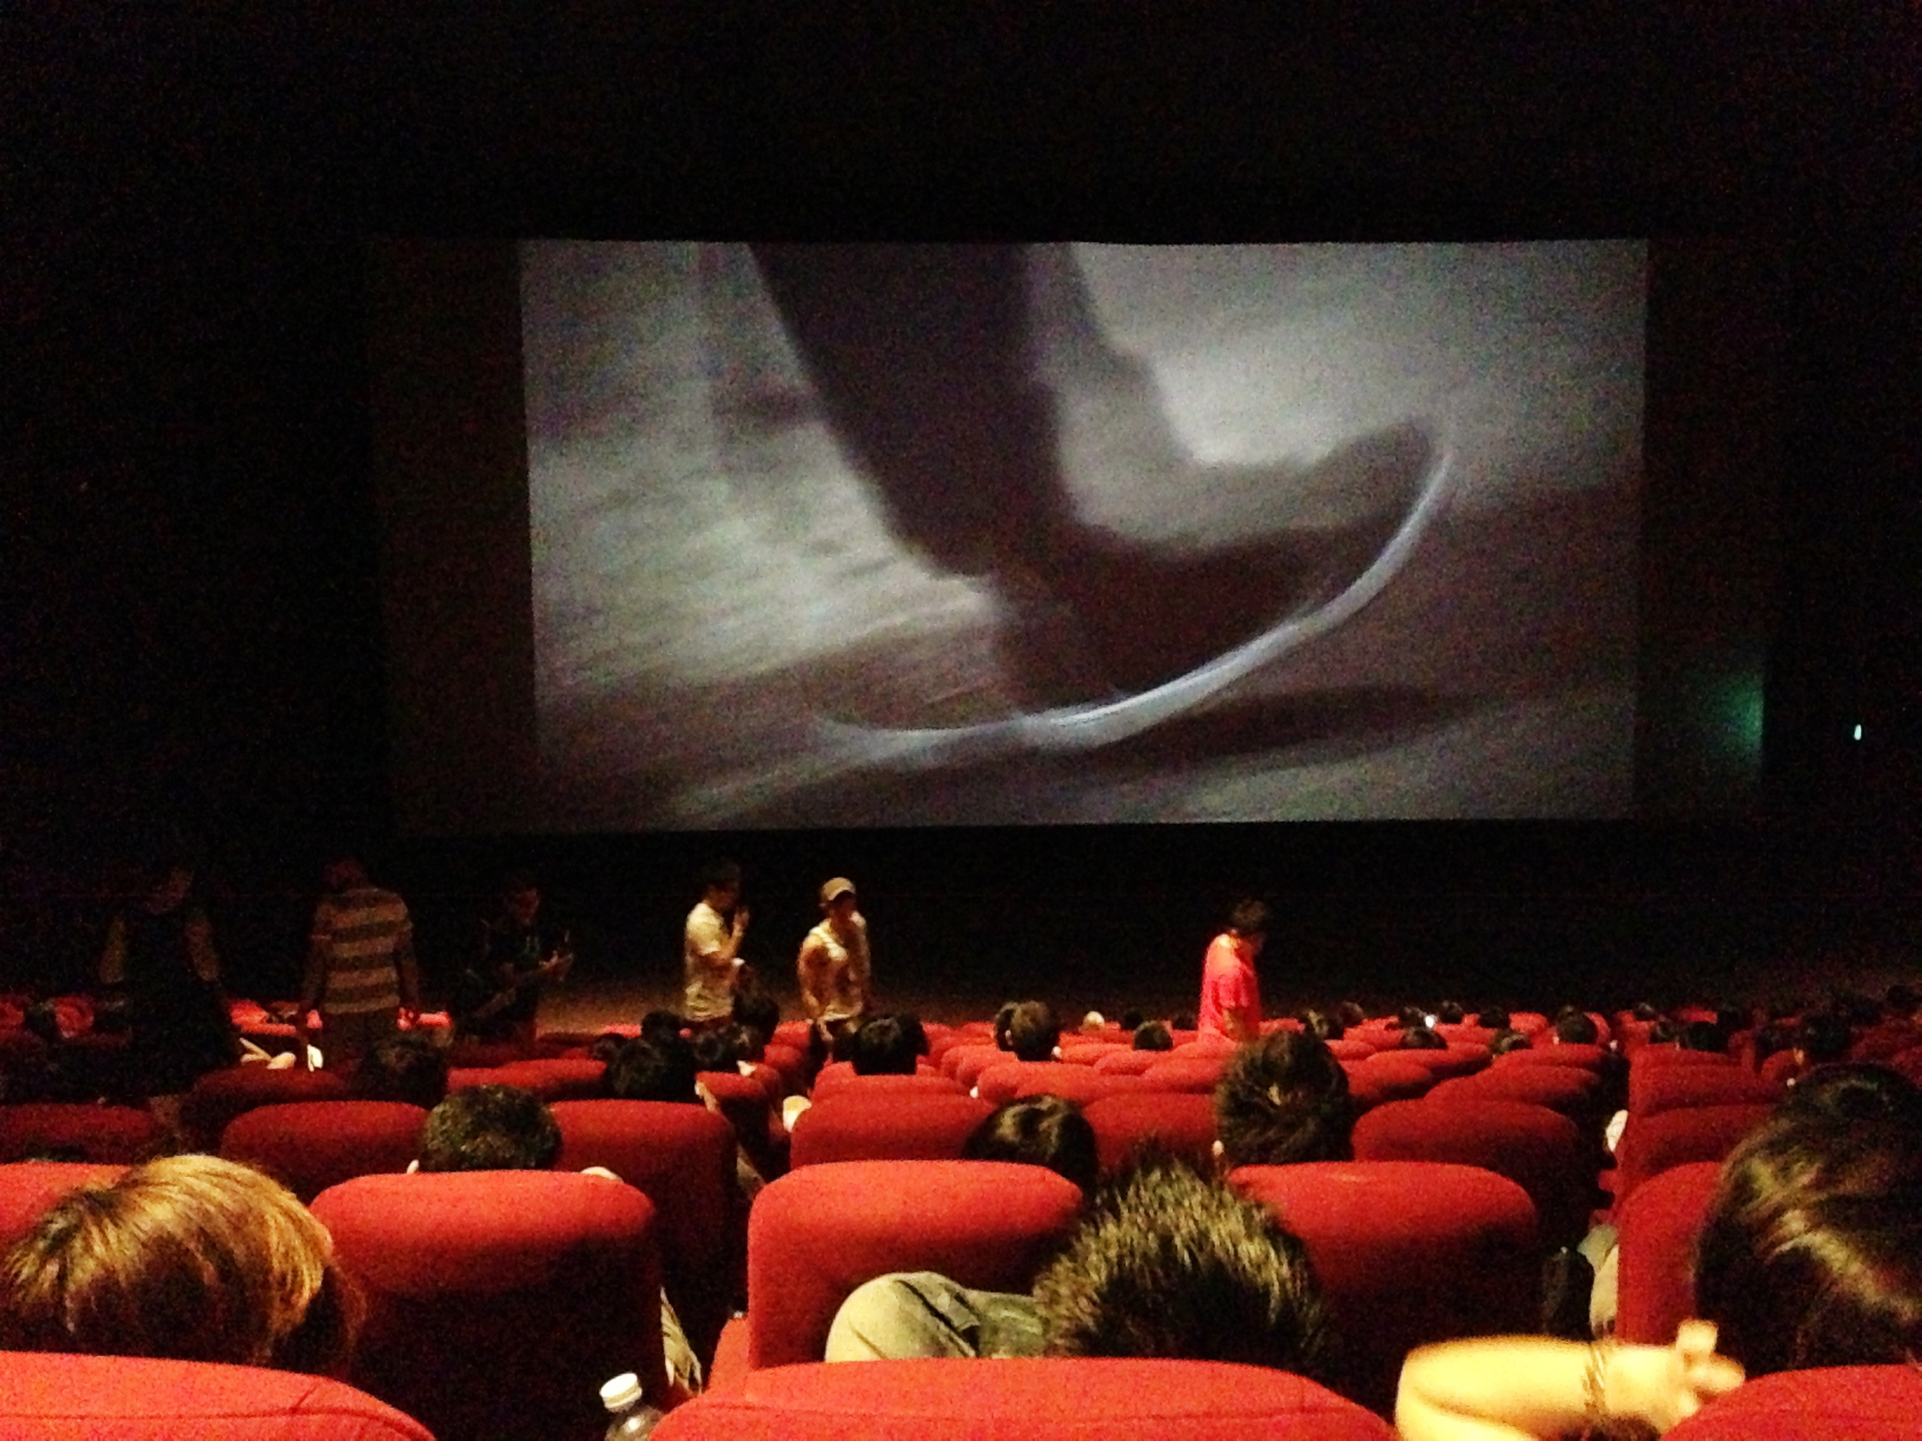
24 fps, ~1 per 40 ms

Slide 9
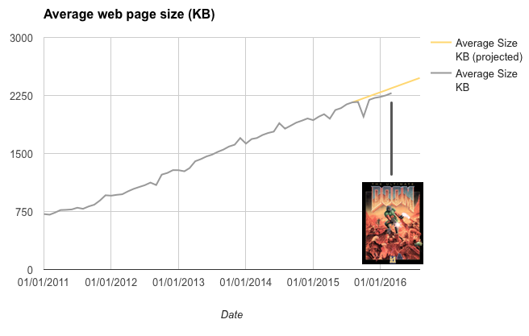
The web is DOOM
https://mobiforge.com/research-analysis/the-web-is-doom

Slide 10
Microservices denial?
Microservices bring together best practices from a variety of areas.
Most likely you are already using some of these best practices.

Slide 11
Microservices denial?
It sounds like marketing hype.

Slide 12
Microservices denial?
It sounds like marketing hype.
It all sounds pretty familiar.

Slide 13
Microservices denial?
It sounds like marketing hype.
It all sounds pretty familiar.
It just a rebranding of stuff we already do.

Slide 14
Microservices denial?
It sounds like marketing hype.
It all sounds pretty familiar.
It just a rebranding of stuff we already do.
There is room for improvement in what we do.

Slide 15
Microservices denial?
It sounds like marketing hype.
It all sounds pretty familiar.
It just a rebranding of stuff we already do.
There is room for improvement in what we do.
There are some tools, and ideas we could apply to our systems without changing too much.

Slide 16

Microservices score card
 | Today | Quick Wins | 6 Months
Simple component based design. | ★★ | ★★☆ | ★★☆
Distributed by JVM and Machine | ★★ | ★★ | ★★☆
Service Discovery | ★ | ★☆ | ★★
Resilience to failure | ★☆ | ★☆ | ★★
Transport agnostic | ★ | ★☆ | ★★
Asynchronous messaging. | ★☆ | ★★ | ★★
Automated, dynamic deployment of services. | ★☆ | ★★ | ★★☆
Service private data sets. | ☆ | ★☆ | ★★
Transparent messaging. | ☆ | ★★ | ★★☆
Independent Teams | ★☆ | ★★ | ★★
Lambda Architecture | ★ | ★★ | ★★★

Slide 17
Using Microservices in Trading Systems
Standard techniques for developing and deploying distributed systems
Shorter time to market.
Easier to maintain.
Simpler programming models.

Slide 18
What Microservices can learn from Trading Systems
Trading system have been working with performant distributed systems for years.
Asynchronous messaging, how to test correctness and performance for latencies you cannot see.
Building deterministic, highly reproducible systems.

Slide 19
What is low latency?
You have a view on how much the response time of a system costs your business.
or
You care about latencies you can only measure as even the worst latencies are too fast to see.

Slide 20
Example of low latency?
An Investment Bank measured the 99.999%ile (worst 1 in 100,000) latency of our Chronicle FIX engine at 450 micro-seconds.
This was unacceptable to them.
We fixed this bug and dropped it to below 35 micro-seconds.

Slide 21
Where do they overlap.
Microservices and Trading Systems have high level principles of
Simple component based design.
Asynchronous messaging.
Automated, dynamic deployment of services.
Service private data sets.
Transparent messaging.
Teams can develop independently based on well defined contracts.

Slide 22
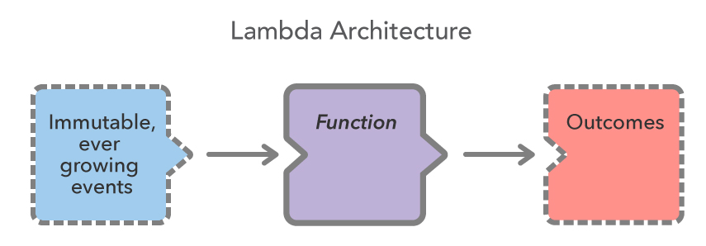
Each output is the result of one input message. This is useful for gateways, both in and out of your system. Highly concurrent.

Slide 23
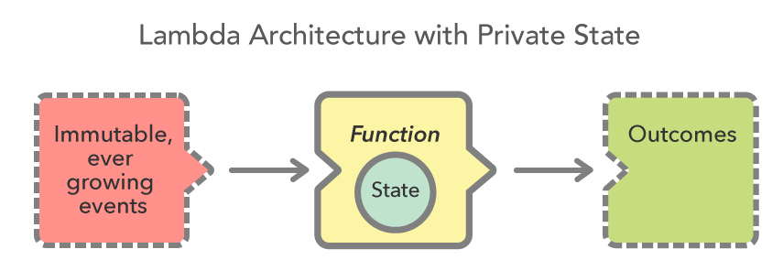
Each output is the result of ALL the inputs. Instead of replying ALL input message each time, the Function could save an accumulated state.

Slide 24
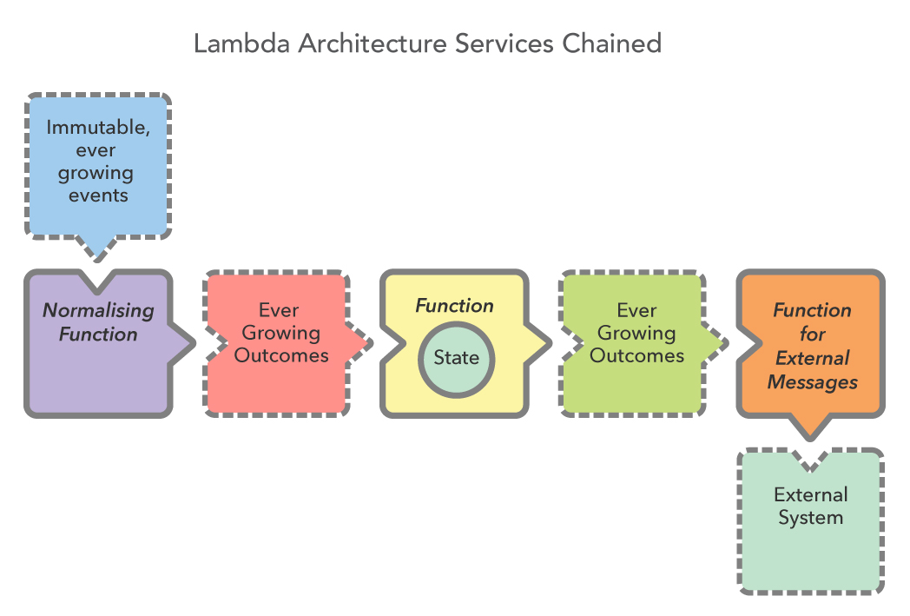
Your critical path as a series of low latency, non blocking tasks. This keeps your latencies end to end consistently low.

Slide 25
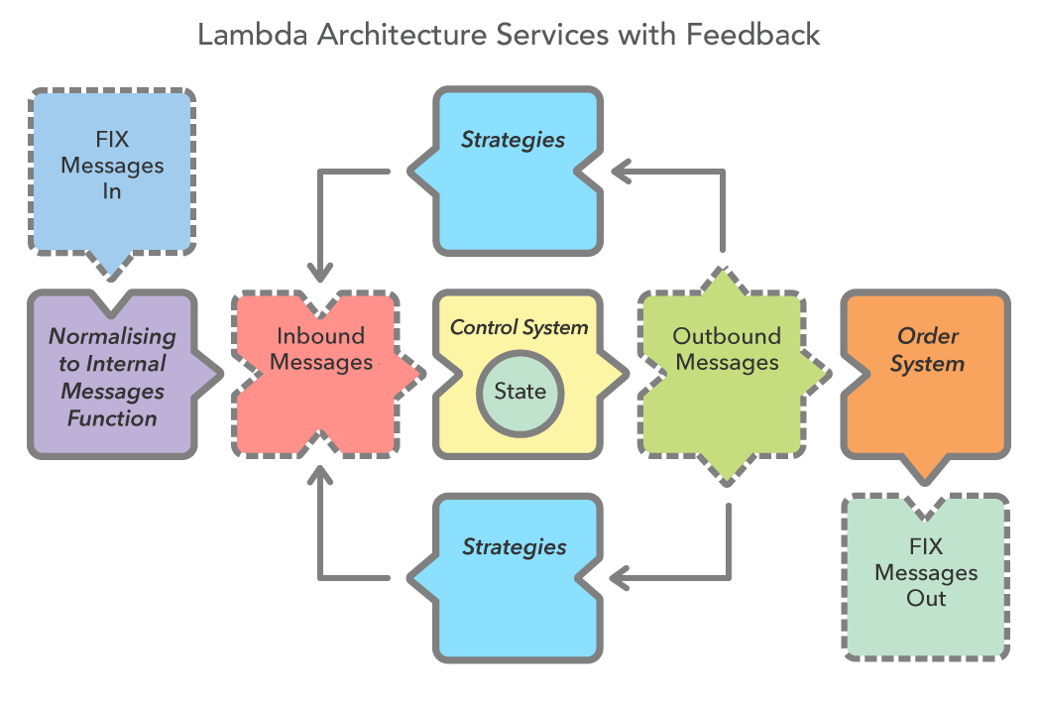

Slide 26
To go faster use private data
Micro-services do something simple with privately held data.
Cache | Size | Clock Cycles | Private
L1 Instruction | 32 KB | 3 | Yes
L1 Data | 32 KB | 3 | Yes
L2 Cache | 256 KB | 10 | Yes
L3 Cache | 1 MB – 48 MB | 40 - 70 | NO

Slide 27
A Computer is a Distributed System.
When you are considering short time scales of 10 micro-seconds or less, you have to consider that each core as a processor of it’s own.
Each core
has it’s own memory (L1 & L2 caches)
can run independently
communicates with other cores via a L2 cache coherence bus.

Slide 28
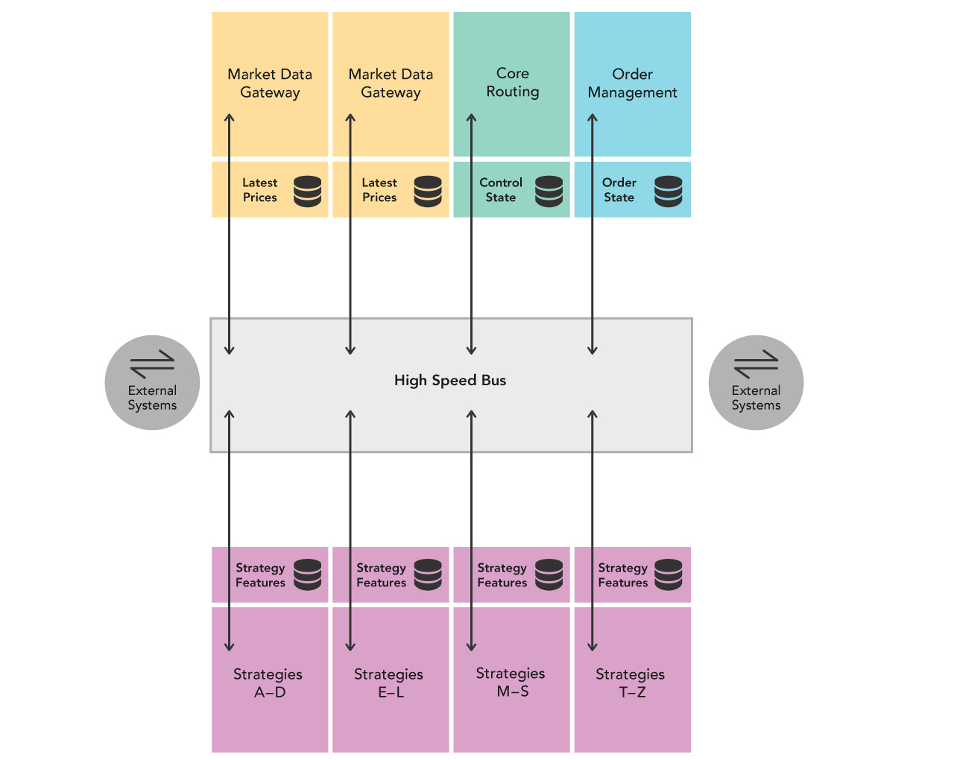

Slide 29
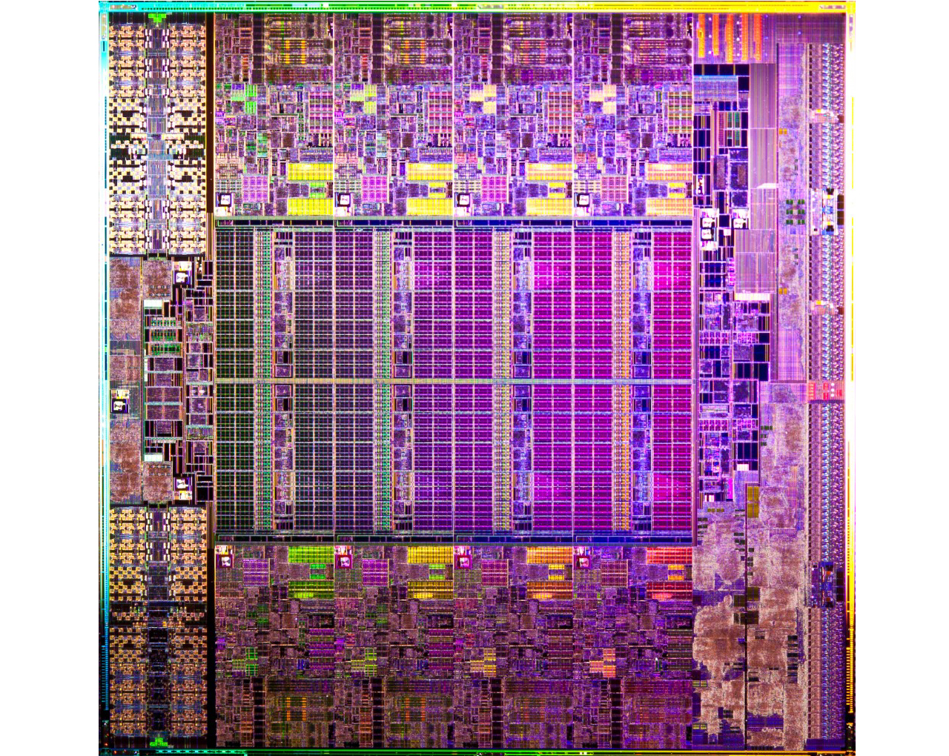

Slide 30
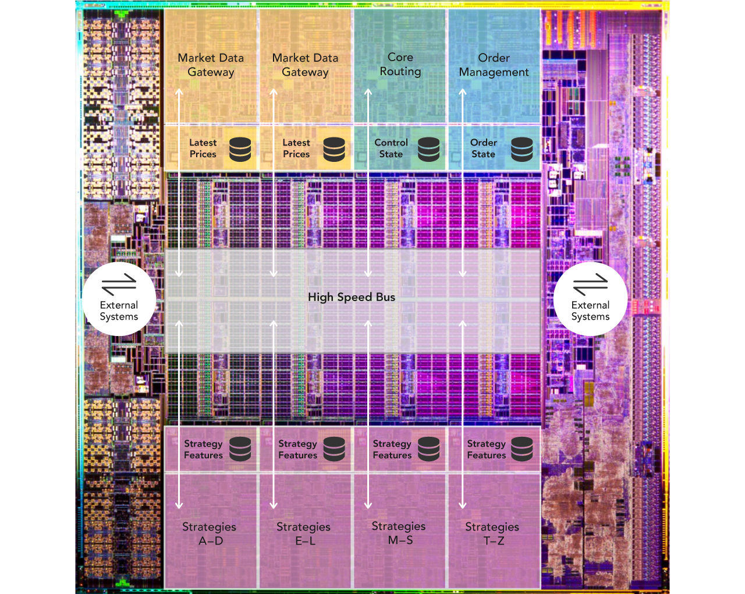

Slide 31
Testing and Debugging Microservices
Frameworks can make testing and debugging harder.
You need to be able to test and debug your components without the framework, or a transport.

Slide 32
Turning a Monolith into Microservices
Business Component + Transport = Service.

Slide 33
Starting with a simple contract
An asynchronous message has a type, a payload and doesn’t return a result.
public interface SidedMarketDataListener { void onSidedPrice(SidedPrice sidedPrice); }
public interface MarketDataListener { void onTopOfBookPrice(TopOfBookPrice price); }

Slide 34
A Data Transfer Object
public class SidedPrice extends AbstractMarshallable { String symbol; long timestamp; Side side; double price, quantity; public SidedPrice(String symbol, long timestamp, Side side,
double price, double quantity) { this.symbol = symbol; this.timestamp = timestamp; this.side = side; this.price = price; this.quantity = quantity; return this; } }

Slide 35
Deserializable toString()
For it to deserialize the same object, no information can be lost, which useful to creating test objects from production logs.
SidedPrice sp = new SidedPrice("Symbol", 123456789000L,
Side.Buy, 1.2345, 1_000_000); assertEquals("!SidedPrice {\n" + " symbol: Symbol,\n" + " timestamp: 123456789000,\n" + " side: Buy,\n" + " price: 1.2345,\n" + " quantity: 1000000.0\n" + "}\n", sp.toString()); // from string SidedPrice sp2 = Marshallable.fromString(sp.toString()); assertEquals(sp2, sp); assertEquals(sp2.hashCode(), sp.hashCode());

Slide 36
Writing a simple component
We have a component which implements our contract and in turn calls another interface with a result
public class SidedMarketDataCombiner
implements SidedMarketDataListener {
final MarketDataListener mdListener; public SidedMarketDataCombiner(MarketDataListener mdListener) { this.mdListener = mdListener; }

Slide 37
Writing a simple component
The component calculates a result, using private state.
final Map<String, TopOfBookPrice> priceMap = new TreeMap<>(); public void onSidedPrice(SidedPrice sidedPrice) { TopOfBookPrice price = priceMap.computeIfAbsent( sidedPrice.symbol, TopOfBookPrice::new); if (price.combine(sidedPrice)) mdListener.onTopOfBookPrice(price); }

Slide 38
Testing our simple component
We can mock the output listener of our component.
MarketDataListener listener = createMock(MarketDataListener.class); listener.onTopOfBookPrice(new TopOfBookPrice("EURUSD", 123456789000L,
1.1167, 1_000_000, Double.NaN, 0)); listener.onTopOfBookPrice(new TopOfBookPrice("EURUSD", 123456789100L,
1.1167, 1_000_000, 1.1172, 2_000_000)); replay(listener); SidedMarketDataListener combiner = new SidedMarketDataCombiner(listener); combiner.onSidedPrice(new SidedPrice("EURUSD", 123456789000L,
Side.Buy, 1.1167, 1e6)); combiner.onSidedPrice(new SidedPrice("EURUSD", 123456789100L,
Side.Sell, 1.1172, 2e6)); verify(listener);

Slide 39
Testing multiple components
We can mock the output listener of our component.
// what we expect to happen OrderListener listener = createMock(OrderListener.class);
listener.onOrder(new Order("EURUSD", Side.Buy, 1.1167, 1_000_000));
replay(listener); // build our scenario OrderManager orderManager =
new OrderManager(listener);
SidedMarketDataCombiner combiner =
new SidedMarketDataCombiner(orderManager);

Slide 40
Testing multiple components
// events in: not expected to trigger orderManager.onOrderIdea(
new OrderIdea("EURUSD", Side.Buy, 1.1180, 2e6)); combiner.onSidedPrice(
new SidedPrice("EURUSD", 123456789000L, Side.Sell, 1.1172, 2e6)); combiner.onSidedPrice(
new SidedPrice("EURUSD", 123456789100L, Side.Buy, 1.1160, 2e6)); combiner.onSidedPrice(
new SidedPrice("EURUSD", 123456789100L, Side.Buy, 1.1167, 2e6));
// expected to trigger orderManager.onOrderIdea(
new OrderIdea("EURUSD", Side.Buy, 1.1165, 1e6));
verify(listener);

Slide 41
Adding a transport
Any messaging system can be used as a transport. You can use
REST or HTTP
JMS, Akka, MPI
Aeron or a UDP based transport.
Raw TCP or UDP.
Chronicle Queue.

Slide 42
Making messages transparent
orderManager.onOrderIdea(
new OrderIdea("EURUSD", Side.Buy, 1.1180, 2e6));
--- !!data #binary
onOrderIdea: {
symbol: EURUSD,
side: Buy,
limitPrice: 1.118,
quantity: 2000000.0
}

Slide 43
Why use Chronicle Queue
Chronicle Queue v4 has a number of advantages
Broker less, only the OS needs to be up.
Low latency, less than 10 microseconds 99% of the time.
Persisted, giving your replay and transparency.
Can replace your logging improving performance.
Kernel Bypass, Shared across JVMs with a system call for each message.

Slide 44
--- !!meta-data #binary
header: !SCQStore { wireType: !WireType BINARY, writePosition: 777, roll: !SCQSRoll { length: 86400000, format: yyyyMMdd, epoch: 0 }, indexing: !SCQSIndexing {
indexCount: !int 8192, indexSpacing: 64, index2Index: 0, lastIndex: 0 } }
# position: 227
--- !!data #binary
onOrderIdea: { symbol: EURUSD, side: Buy, limitPrice: 1.118, quantity: 2000000.0 }
# position: 306
--- !!data #binary
onTopOfBookPrice: { symbol: EURUSD, timestamp: 123456789000, buyPrice: NaN,
buyQuantity: 0, sellPrice: 1.1172, sellQuantity: 2000000.0 }
# position: 434
--- !!data #binary
onTopOfBookPrice: { symbol: EURUSD, timestamp: 123456789100, buyPrice: 1.116, buyQuantity: 2000000.0, sellPrice: 1.1172, sellQuantity: 2000000.0 }
# position: 566
--- !!data #binary
onTopOfBookPrice: { symbol: EURUSD, timestamp: 123456789100, buyPrice: 1.1167, buyQuantity: 2000000.0, sellPrice: 1.1172, sellQuantity: 2000000.0 }
# position: 698
--- !!data #binary
onOrderIdea: { symbol: EURUSD, side: Buy, limitPrice: 1.1165, quantity: 1000000.0 }
...
# 83885299 bytes remaining

Slide 45
Measuring the performance?
Measure the write latency with JMH (Java Microbenchmark Harness)
Percentiles, us/op:
p(0.0000) = 2.552 us/op
p(50.0000) = 2.796 us/op
p(90.0000) = 5.600 us/op
p(95.0000) = 5.720 us/op
p(99.0000) = 8.496 us/op
p(99.9000) = 15.232 us/op
p(99.9900) = 19.977 us/op
p(99.9990) = 422.475 us/op
p(99.9999) = 438.784 us/op
p(100.0000) = 438.784 us/op

Slide 46
No Flow Control?
Market Data
Compliance

Slide 47
In summary
Microservices doesn’t mean you have to do everything differently, only improve what you are doing already.

Slide 48
In summary
Microservices doesn’t mean you have to do everything differently, only improve what you are doing already.
Introduce the Best Practices which make sense for you.

Slide 49
In summary
Microservices doesn’t mean you have to do everything differently, only improve what you are doing already.
Introduce the Best Practices which make sense for you.
You will have some Best Practices already.

Slide 50
In summary
Microservices doesn’t mean you have to do everything differently, only improve what you are doing already.
Introduce the Best Practices which make sense for you.
You will have some Best Practices already.
Trading Systems are distributed systems, even on one machine.

Slide 51
In summary
Microservices doesn’t mean you have to do everything differently, only improve what you are doing already.
Introduce the Best Practices which make sense for you.
You will have some Best Practices already.
Trading Systems are distributed systems, even if on one machine.
Lambda Architecture is simple, so use it as much as possible.

Slide 52
Where can I try this out?
Low Latency Microservices examples
https://github.com/Vanilla-Java/Microservices
The OSS Chronicle products are available
https://github.com/OpenHFT/

Slide 53
Q & A
Blog: http://vanilla-java.github.io/
http://chronicle.software
@ChronicleUG
sales@chronicle.software
https://groups.google.com/forum/#!forum/java-chronicle

